Slide 1

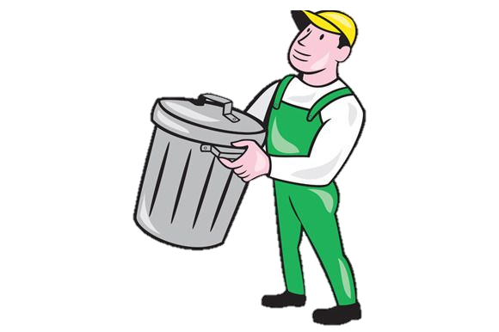
I am
Recycling Center Staff
I am
Recycling Hero

